Slide 1
Image Noise
Salt and Pepper Noise
Salt and pepper noise, also known as impulse noise, refers to noise that appears as if salt and pepper (white and black pixels) has been sprinkled on top of an image. It is often caused by sharp and sudden disturbances in the image signal.
The median filter is very effective method for reducing this type of noise, while the Max and min filters are very efficient in removing only pepper and salt noise, respectively.

Slide 2
Image Noise
Salt and Pepper Noise
For this exercise, you are tasked to corrupt an image with salt and pepper, salt or pepper noise, depending on the user’s preference.
The algorithm takes as input an image and a float number from 0 to 1 that corresponds to a probability. Based on that probability, it corrupts the image with salt and pepper noise. Then the noise image is returned. Two similar functions are created, one for salt and one for pepper noise.
The user decides the type of noise that will corrupt the image and, finally, the original image is displayed alongside the noise one.

Slide 3


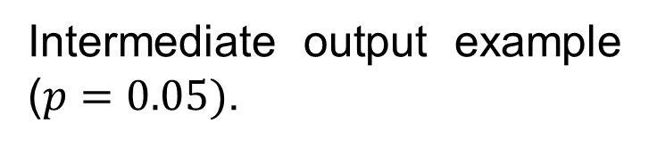
Image Noise
Salt and Pepper Noise
Input example.
Intermediate output example ($p=0.05)$.

Slide 4
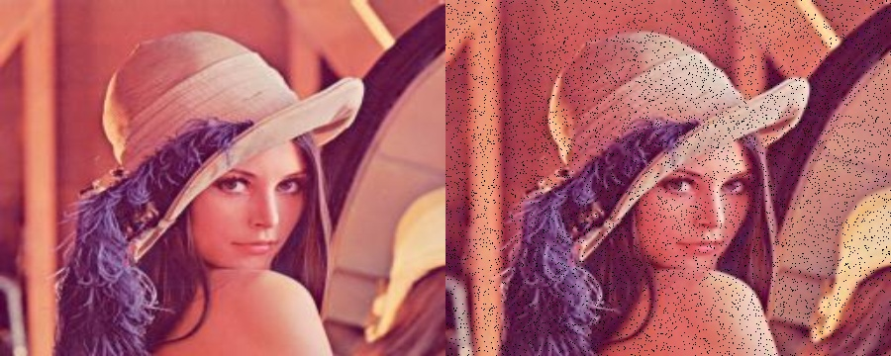
Image Noise
Salt and Pepper Noise
Output example (Pepper noise where $p=0.05$).

